Slide 1
Internet Technical Committee Meeting
ICC 2015
June 9, 2015
London, UK
Jaime Lloret Mauri (Technical University of Valencia, Spain)
Stefano Secci (University Pierre and Marie Curie, France)
Dijiang Huang (Arizona State University)

Slide 2
Meeting Agenda
1. Welcome & Introduction
2. Approval of GC 2014 minutes.
3. 2013 ITC Best Paper Award announcement
4. Conference and ICC/GC Symposium updates
5. Updates from Special Interest Groups and Standards Activities
6. Journal/magazine publication activities
7. ComSoc Student Competition 2015
8. Open Discussions and Other Business
9. Adjourn

Slide 3
1. Welcome & introduction
Structure: IEEE, ComSoc, and TAC
IEEE
IEEE Communication Society (ComSoc)
One of the 38 societies of IEEE
ComSoc Technical Activities Council (TAC)
Members: VP Technical Activities, TAC Vice-chair, TC Chairs and Vice-chairs
23 TCs, 13 Emerging Tech. Subcommittees: http://www.comsoc.org/about/committees/Technical
Internet TC is a joint tech. committee of ComSoc and ISOC

Slide 4
1. ITC Officers
Officers (2013-2015):
Chair: Jaime Lloret Mauri (Technical University of Valencia, Spain)
Vice-Chair: Stefano Secci (University Pierre and Marie Curie, France)
Secretary: Dijiang Huang (Arizona State University, USA) Elected in Nov. 2013. Next elections: Fall 2015.
Previous Chairs (1995-2013):
Xiaoming Fu (2011-2013), Deep Medhi (2007-2011), Markus Hoffman (2004-2007), Joe Touch (2000-2004), Henning Schulzrinne (1995-2000)

Slide 5
1. ITC Community
866
Subscribing: send an email to listserv@comsoc.org and type in the body of the message "join itc FirstName FamilyName”

Slide 6
2. Approval of ITC GC 2014 meeting Minutes
http://committees.comsoc.org/itc/reports/itc-meeting-2014.pdf

Slide 7
3. 2013 ITC Best Paper Award
A new award recently set up by ITC
2013-2014 Committee
Deep Medhi (UMKC) - Chair; Jorg Liebeherr (U. Toronto); Lixin Gao (UMass)
Eligibility
Only papers that have been published in conferences held during the preceding calendar year, which have been endorsed by the Internet Technical Committee of IEEE Communications Society, are eligible for the ITC best paper award

Slide 8
3. 2013 ITC Best Paper Award
Gautam S. Thakur & Ahmed Helmy, COBRA: A Framework for the Analysis of Realistic Mobility Models [GLobal Internet Symposium 2013]

Slide 9
3. 2014 ITC Best Paper Award
Still in the decision process.

Slide 10
4. Conference Update
Global Internet Symposium @ IEEE INFOCOM 2015
IEEE ICC & GLOBECOM 2017
Status of other endorsed conferences
Recently endorsed conferences
MEDHOCNET 2015, June 17-18, 2015 - Vilamoura, Algarve, Portugal: http://medhocnet2015.uc.pt/
ICACCI 2015, Kochi, Kerala, India, August 10-13, 2015:
http://icacci-conference.org/web/
IEEE SARNOFF 2015, September 20-22, 2015, Newark, NJ, USA: http://ewh.ieee.org/conf/sarnoff/2015/
NETGAMES 2015, December 3-4, 2015, Zagreb, Croatia: http://netgames2015.fer.hr/
CoCoNet 2015, December 16-19, 2015, Trivandrum, Kerala: http://www.iiitmk.ac.in/coconet2015/
(around 2900 submissions)

Slide 11
4. IEEE INFOCOM Global Internet Symposium
Rule of the composition of the GISC (GI Steering Committee)
The ITC chair acts as GISC chair, old ITC chair keeps in the GISC untill there is a new chair
one from each of recent 3-4 editions of GI, considering the institution/country/continent diversity maximization as first criterion.
New GISC
Jaime Lloret Mauri (UPV)
Xiaoming Fu (U Goettingen)
Marcelo Bagnulo Braun (UC3M)
Colin Perkins (U.Glasgow)
Joerg Ott (Aaalto U)
Jun Li (U of Oregon, USA)

Slide 12
4. 18th IEEE INFOCOM Global Internet Symposium
http://gi2015.ist.osaka-u.ac.jp/index.html
TPC co-chairs: Toru Hasegawa (Osaka University, Japan) y Jiangchuan Liu (Simon Fraser University, Canada)
There were 29 submission from 17 countries. (this is a 38% increase compared to the number of submissions received in 2014), 9 papers accepted, an acceptance ratio of 32%, and 24 attendees.
According the advices from the TPC Co-chairs of GI 2014, GI 2015 introduced publicity/Web chairs and the best paper award.

Slide 13
4. IEEE GLOBECOM & ICC
Nominations – refresh on the procedure
About the co-chair position: each symposium will have its own technical program committee that is managed by a set of 2-4 Symposium Co-Chairs. The co-chairs retain full responsibility for all aspects of the symposium technical program, including the shaping of its technical program, managing the review process, selecting accepted papers, and organizing its sessions. Symposium co-chairs are highly respected leaders in their fields of expertise, with outstanding records of IEEE publications and proven experience in the peer review process.
Strongest profiles will be nominated so as to increase selection chances
Send nominations to ITC_Officers@comsoc.org

Slide 14
4. IEEE ICC 2017
Next Generation Networking
Shiwen Mao, Auburn University
Communications Software and Services
Pietro Mazoni, University Politecnica Valencia
Selected Areas in Communications Symposium Cloud Networks Track
Papapanagiotou, Ioannis

Slide 15
4. IEEE GLOBECOM 2017
Next Generation Networking
Al-Shakib Khan Pathan, International Islamic University Malaysia
Communications Software and Services
Lei Shu, Guangdong University of Petrochemical Technology
Selected Areas in Communications Symposium Cloud Networks Track
Not decided by us

Slide 16
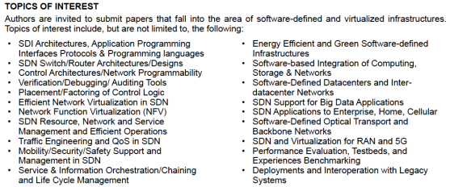
4. IEEE NETSOFT 2015
Following SDN4FNS 2013 (exploratory workshop)
Financially sponsored by the IEEE SDN Initiative: http://sdn.ieee.org
ITC representatives: Prosper Chemouil, Jaime Lloret Mauri, Stefano Secci

Slide 17
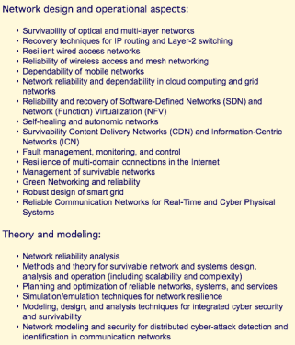
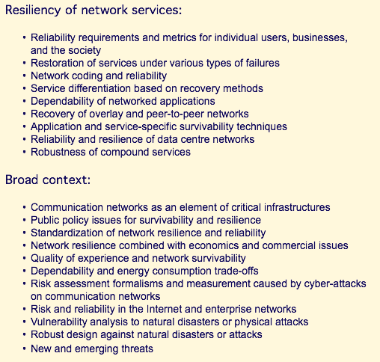
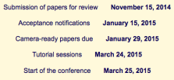
6. DRCN 2015
Following SDN4FNS 2013 (exploratory workshop)
ITC representatives: Deep Medhi, Prosper Chemouil, Stefano Secci

Slide 18
4. DRCN 2016
https://drcn2016.lip6.fr/
The 12th DRCN will be held in Paris, at the University Pierre and Marie Curie (UPMC), in March 14-17, 2016.

Slide 19
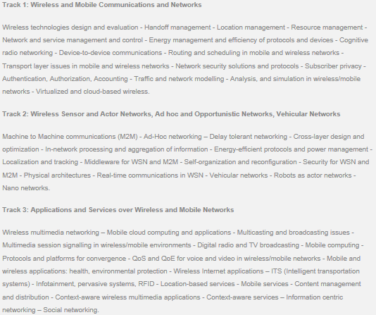
Moved to
October 5-7 2015 in Munich, Germany.

Slide 20
5. Special Interest Groups
ITC gives importance to cutting-edge research areas opening Special Interest Groups and supporting related activities such as:
Special Issues,
Conferences, Workshops.
Large research projects, Standardization.
If you are active on any of the active SIG area, please get in contact with the ITC representative to allow listing and reporting.
Stay tuned on : http://committees.comsoc.org/itc/activities.html#SIG

Slide 21
5. ITC Special Interesting Group (SIG)
IoT
Resp: Rui L. Aguiar
Cloud Networking
Resp.: Jose M. Alcaraz Calero, Scotland
Location ID Separation (LIS) – SIG website now online!
Resp.: Luigi Iannone, France
Information-Centric Networking – SIG website now online!
Resp.: Mayutan Arumaithurai, Germany
More information, see
http://committees.comsoc.org/itc/activities.html

Slide 22
5. Call for new Special Interest Groups
New propositions are welcome!
A SIG is generally opened
on a very recent subjects in Internet-working,
if there is a clear activity related to the subject,
Conferences, workshops, special issues, standardization, large research projects, etc
in which ITC members are involved and willing to report.
Please send propositions to ITC_officers@comsoc.org

Slide 23
5. ITC Activities on Standards
IEEE ComSoc Standards Board Representative: Periklis Chatzimisios, ATEITHE, Greece 2014 Report:
ISOC/IRTF Representative: Luigi Iannone, Telecom ParisTech, France 2014 report

Slide 24
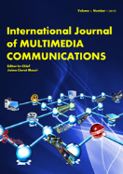
6. Journal/magazine publication activities
Journal of Multimedia Communications
ISSN 2378-6507 (Print), ISSN 2378-6515 (Online), published by Old City Publishing Inc.
http://www.oldcitypublishing.com/journals/ijmc-home/
Jaime Lloret Mauri (IG member): nominated as Editor-in-Chief.
Welcome to join the editorial board!

Slide 25
6. Journal/magazine publication activities
Special Issue on Emerging Technologies for Robust and Resilience Communication Networks
The Scientific World Journal, Hindawi
http://www.hindawi.com/journals/tswj/si/360937/cfp/
Applied Mathematics and Algorithms for Cloud Computing and IoT 2014
Mathematical Problems in Engineering, Hindawi
http://www.hindawi.com/journals/mpe/si/461391/cfp/

Slide 26
10. ComSoc Student Competition 2015
It has started!
New submission: http://www.comsoc.org/communications-technology-changing-world
In 2014: there were 42 Submissions
FIRST PRIZE
27 AVATARS: A Software Defined Radio based Teleoperating Cyber-Physical System for Disaster Environment Exploration. Li'an Li Shanghai Jiao Tong University
SECOND PRIZE (ex aequo)
42 Nature-inspired Molecular Diffusion Communication Test-bed for Harsh Communication Environments. Siyi Wang Institute for Telecommunications Research, University of South Australia
14 A System for Affordable Internet Access in Rural Developing Nations. Esther Jang MIT

Slide 27
11. Other Business
Do you have any planned/ongoing activities related to ITC?
Do you like to contribute to ITC (and ComSoc in general)?
Join ITC:
Join the mail list by sending an email to listserv@comsoc.org and type in the body of the message "join itc FirstName FamilyName”
Participate/raise discussions in the list
Provide your inputs and help

Slide 28
12. Adjourn
Next tentative ITC meeting:
IEEE GLOBECOM 2016
6-10 December 2015
San Diego, CA, USA

